Slide 1
Statistics with Spa ows
Lecture 11-c
Julia Schroeder
Julia.schroeder@imperial.ac.uk

Slide 2
Outline
Linear models – going big
Multiple continuous predictors
Interactions between continuous predictors
Interactions between categorical predictors
…

Slide 3
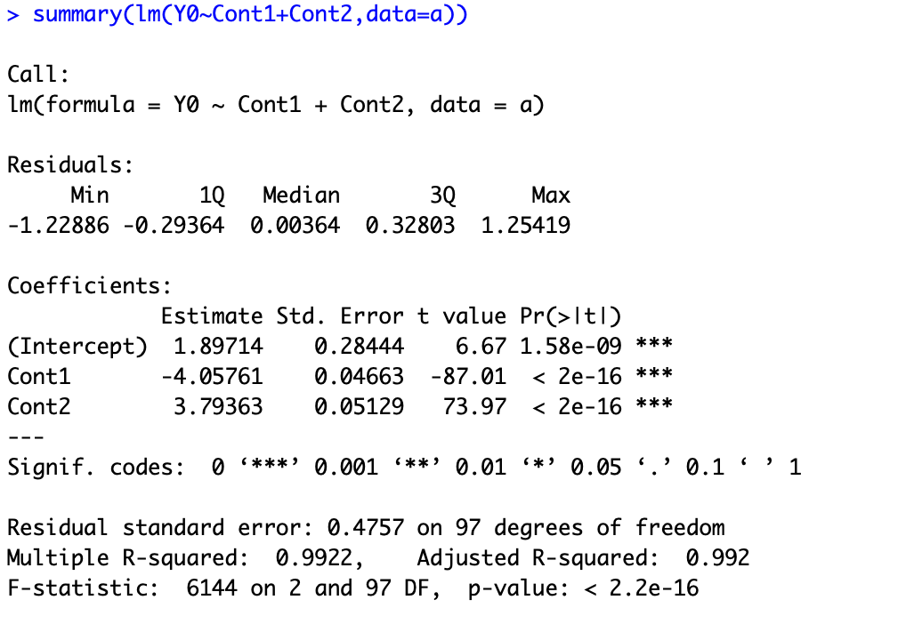
Multiple continuous predictors
Main effects cannot be interpreted in isolation
IF Cont2 is being held constant, then, with increasing Cont1, Y increases
If Cont1 is being held constant, then, with increasing Cont2, Y decreases
-> cannot visualize well
- helpful to account for environmental variables

Slide 4
Interactions between continuous predictors
Really hard (if not impossible) to properly interpret
Only do this if you know what it means

Slide 5
Interactions between categorical predictors
Cat1: male, female
Cat2: Orange, Green, Purple
→ Possible combinations:
Male Orange, Male Green, Male Purple
Female Orange, Female Green, Female Purple

Slide 6
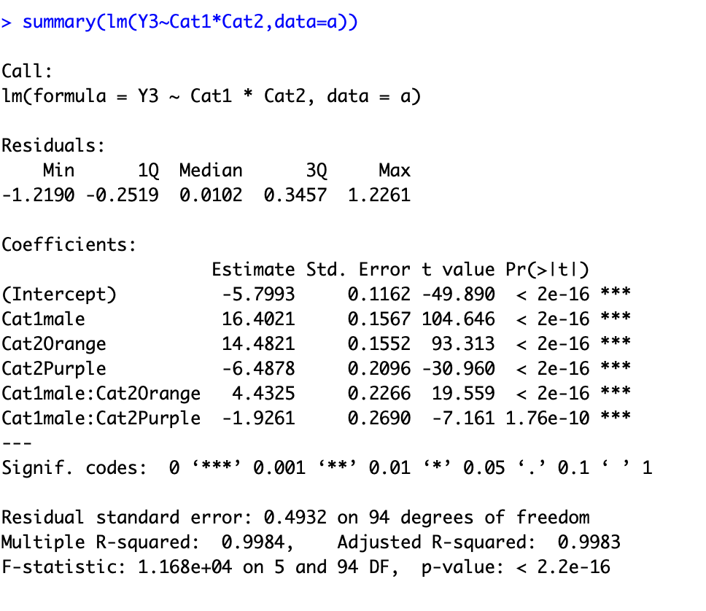
Interactions between categorical predictors
Female Green (Reference): b₀
Difference between reference and
Male Green: b₀ + b₁
Female Orange: b₀ + b₂
Female Purple: b₀ + b₃
Male Orange: b₀ + b₄
Male Purple: b₀ + b₅
b0
b1
b2
b3
b4
b5

Slide 7
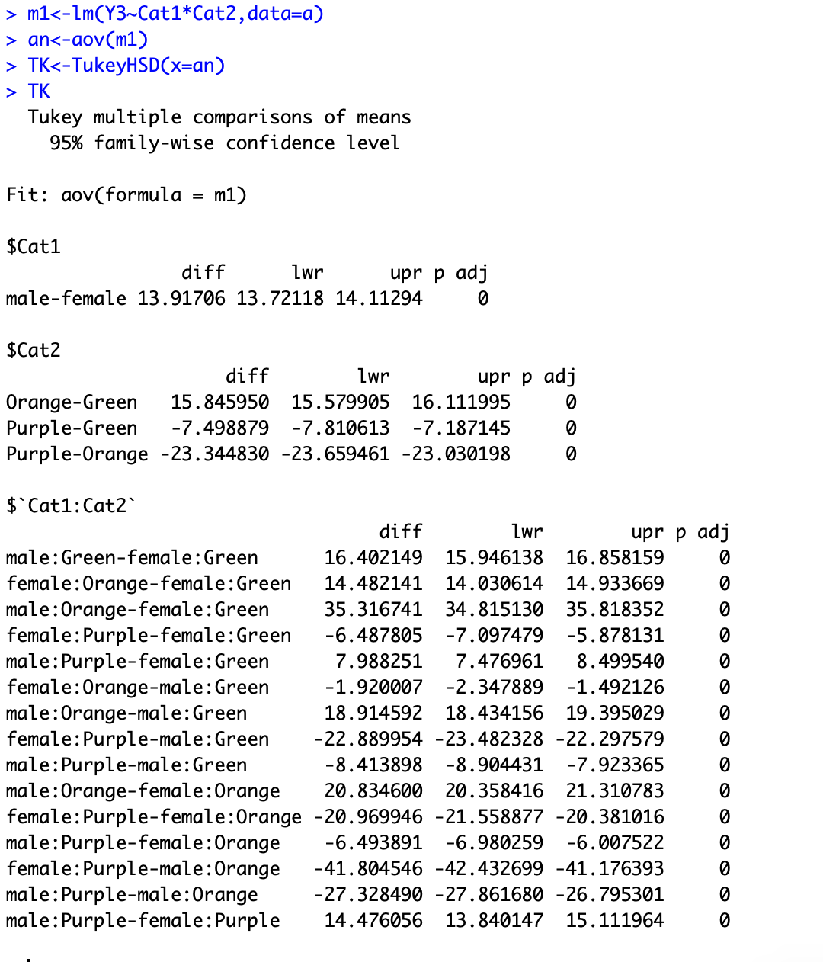
Interactions between categorical predictors
Does not test between all categories
→ Tukey test

Slide 8
What to use when
Depends on your question
Do you want to:
- predict
- explain
explore
account for variables
…

Slide 9
Take home
When running models, always be aware what is categorical and what is continuous, because the the interpretation differs
Know your data structure!
Do not overfit – less complex models are better

